Slide 1
North Chenango River Corridor
Brownfield Opportunity Area
Community Conversation
November 14, 2013

Slide 2
Tonight’s Agenda
Project Overview and Summary
Review of Process
Plan Presentation
Implementation Measures
Q/A - Next Steps

Slide 3
The Team
NYSDOS – Office of Communities and
Waterfronts Division of Coastal Resources
Julie Sweet
NYS Department of
Environmental Conservation
Gary Priscott
City of Binghamton
Planning, Housing and Community Development – City Project Coordinator
Tarik Abdelazime, Planning, Housing and Community Development Director
Leigh McCullen, Senior Planner
The North Chenango River Corridor
Steering Committee
Public Feedback,
Stakeholders
VHB
HR&A
Linda Shaw /
Knauf Shaw LLP

Slide 4
What is the Purpose of the BOA Program?
Assess the community impacts caused by brownfields, economic distress
Build a shared community vision and consensus on the reuse and redevelopment of strategic sites and actions to achieve community revitalization
Identify community redevelopment and revitalization opportunities Coordinate and collaborate with local, state, and federal agencies, community groups and private-sector partners to identify and implement solutions to improve communities
Develop public-private sector partnerships to leverage investment and implement revitalization projects

Slide 5
North Chenango River Community Vision and Goals
The City of Binghamton, as part of it public outreach component, conducted a visioning session where participants were asked to provide input on the vision of the North Chenango River corridor BOA. The full extent of the comments from the first public workshop are contained in Appendix __ of this report.
In the next ten years The North Chenango River Corridor area will become an more attractive, walkable and welcoming gateway to the City of Binghamton with vibrant neighborhoods and with stronger linkages to the rest of the City of Binghamton. While Tthe core of the neighborhood has an existing merchant and restaurant base, it has started to be become a more will be an active and appealing commercial destination that both serves the needs of the nearby residents and attracts visitors and economic activity from the Greater Binghamton region. New development will highlight and complement the area’s unique historic, natural and cultural resources and contribute to a more pedestrian-friendly environment. Building on the existing commercial core in the Study Area, the City will continue to pursue Oopportunities for enhancing the City’s tax base and employment that are compatible and supportive of the City’s economy will be pursued. The surrounding residential areas will be well-maintained and new infill development that is consistent with the established character and scale of these neighborhoods will support a diverse population and array of housing opportunities. Improved connections amongst the residential neighborhoods, a revitalized core, the Chenango River, and park/recreation facilities will encourage physical activity and contribute to a coherent sense of place.
The following implementation goals were also identified:
Work with and engage the owners of Binghamton Plaza site to address issues of access and property reinvestment that would benefit all affected stakeholders.
A priority should ne established to address vacant, deteriorating or derelict properties commercial and residential properties within the study area which provide an uninviting appearance and discourage investment.
Identify redevelopment opportunities that address market and community needs such as housing and grocery store.
Facilitate residential development that attracts mixed-income populations such as empty-nesters and students, to enhance the socioeconomic diversity of the area while retaining and maintaining the existing housing stock for low income residents.
Identify ways of enhancing access, particularly for pedestrians and bicyclists, to balance of the city.
The Study Area played an important role in the development of many commercial and industrial innovations. The promotion of an Innovation Zone as a marketing concept should be pursued to attract business incubator type businesses and as a regional tourist destination.

Slide 6
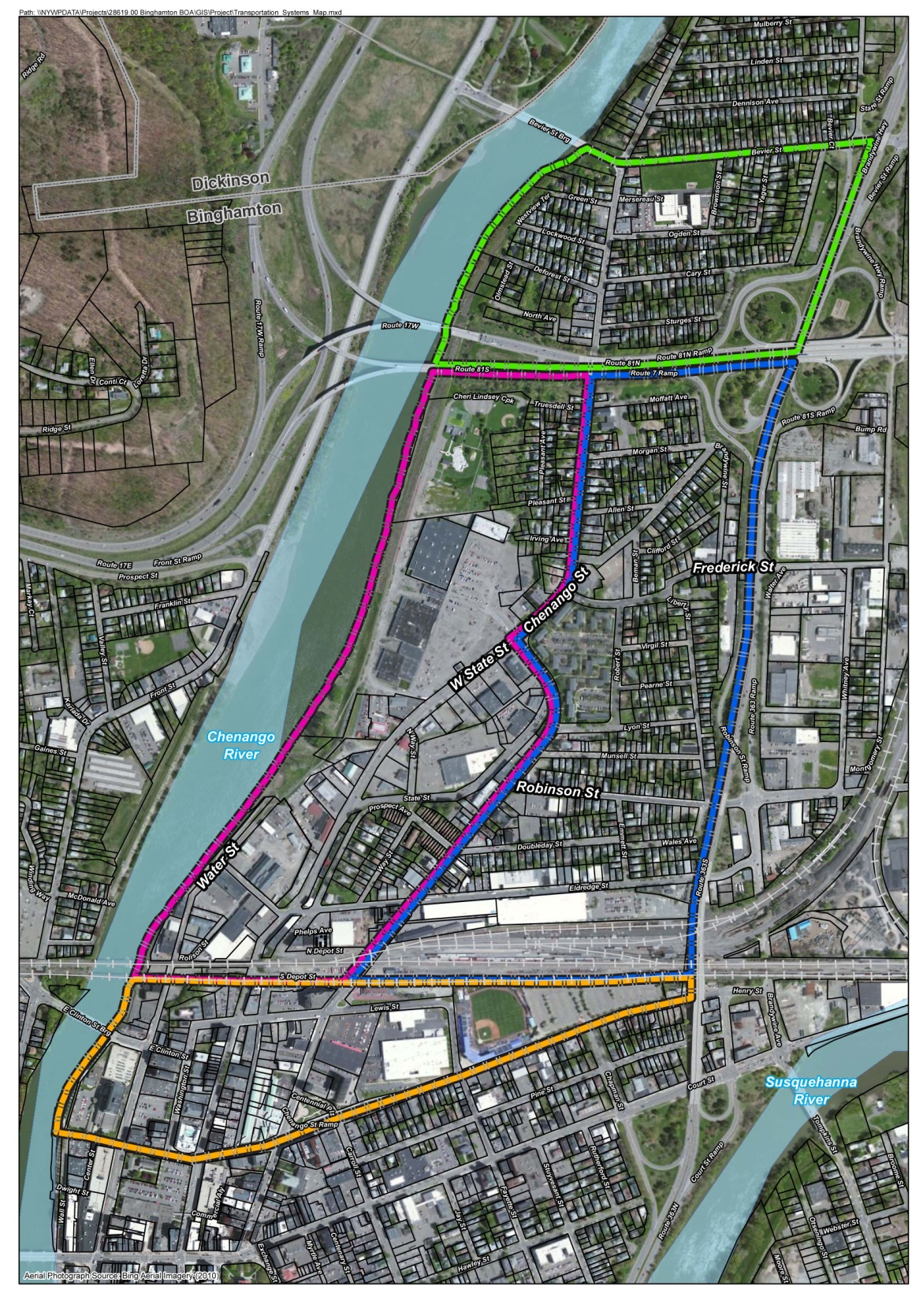
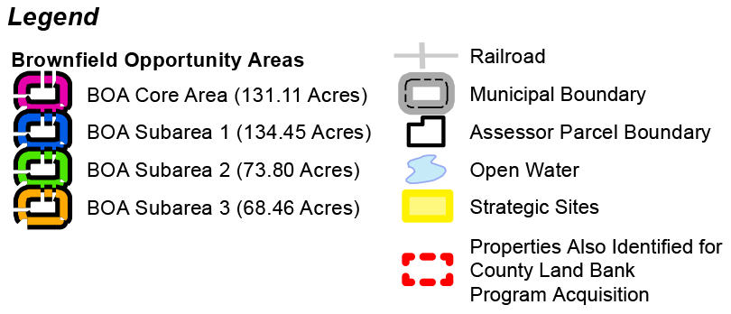
North Chenango River Corridor
Brownfield Opportunity Area
Strategic Sites (Proposed)

Slide 7
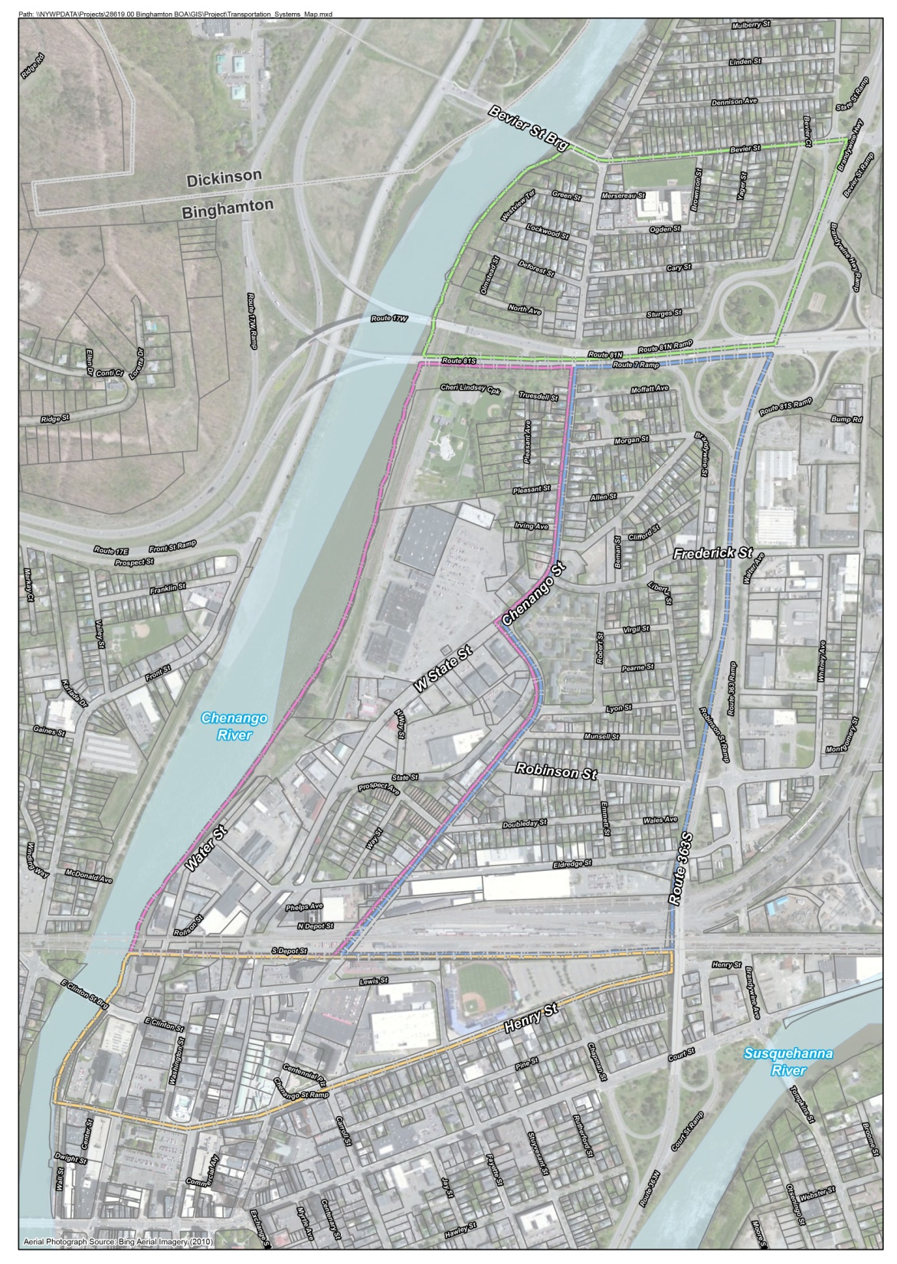
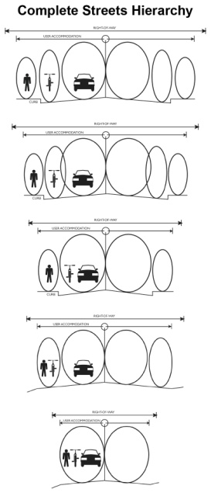
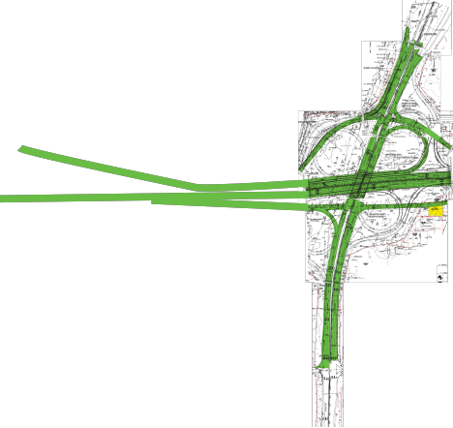
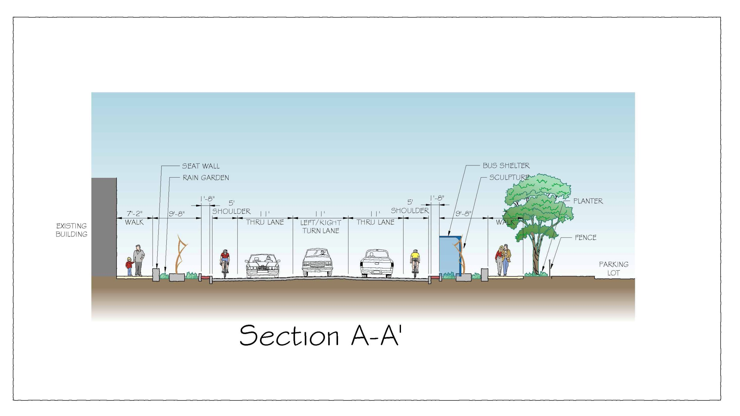
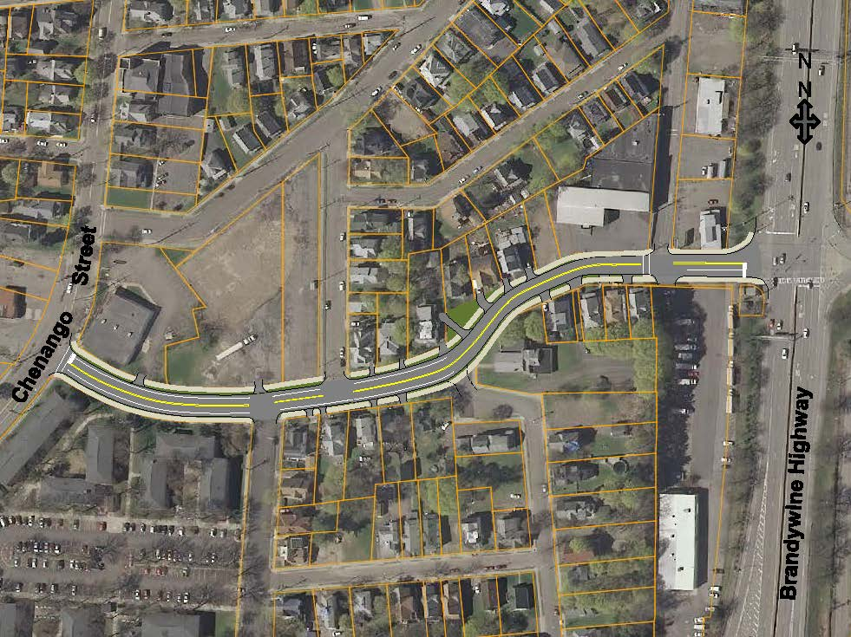
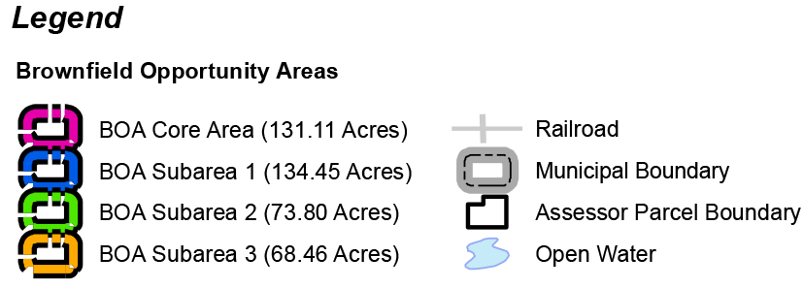
North Chenango River Corridor
Brownfield Opportunity Area
Suggested Proposals and Recommendations
Connectivity and Streetscape
Proposed roadway and circulation improvements
Connectivity and Streetscape
Current roadway improvements
Incorporate “Complete Streets” concepts consistent with City Code
Potential Extension of Binghamton University Bus Service
(approximate location)

Slide 8
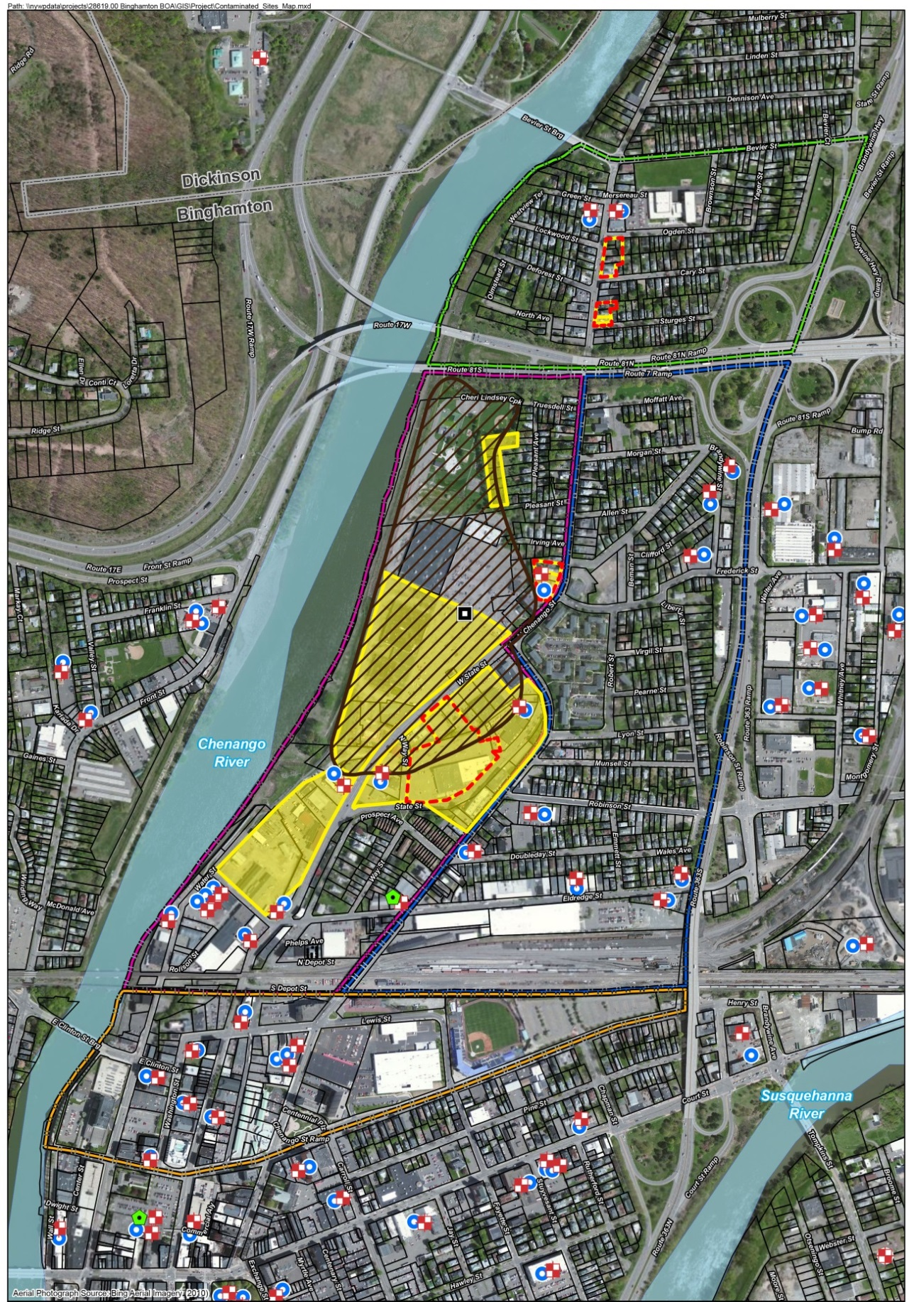
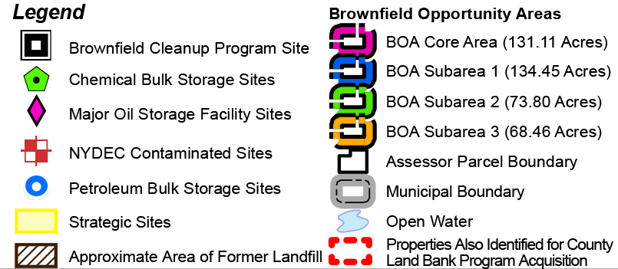
North Chenango River Corridor
Brownfield Opportunity Area
Suggested Proposals and Recommendations
Land Use and Strategic Development
Development Constraints
Stable residential neighborhood but with signs of disinvestment (abandoned buildings). City ownership of abandoned buildings creates a strain on limited municipal resources. Need to evaluate how to better connect the neighborhood with the balance of the City.
New configuration at 17/81 interchange opens up some limited development opportunities
Stable residential neighborhood but with signs of disinvestment (abandoned buildings). City ownership of abandoned buildings creates a strain on limited municipal resources. Need to evaluate how to better connect the neighborhood with the balance of the City.
(approximate location)

Slide 9
North Chenango River Corridor
Brownfield Opportunity Area
Land Planning Framework

Slide 10
North Chenango River Corridor
Brownfield Opportunity Area
Land Planning Framework

Slide 11
North Chenango River Corridor
Brownfield Opportunity Area
Land Planning Framework

Slide 12
North Chenango River Corridor
Brownfield Opportunity Area
Land Planning Framework
General Rule of Thumb
2.5 job/1,000 g.f.a.
Preliminary Evaluation
$6.30/s.f. tax revenue

Slide 13
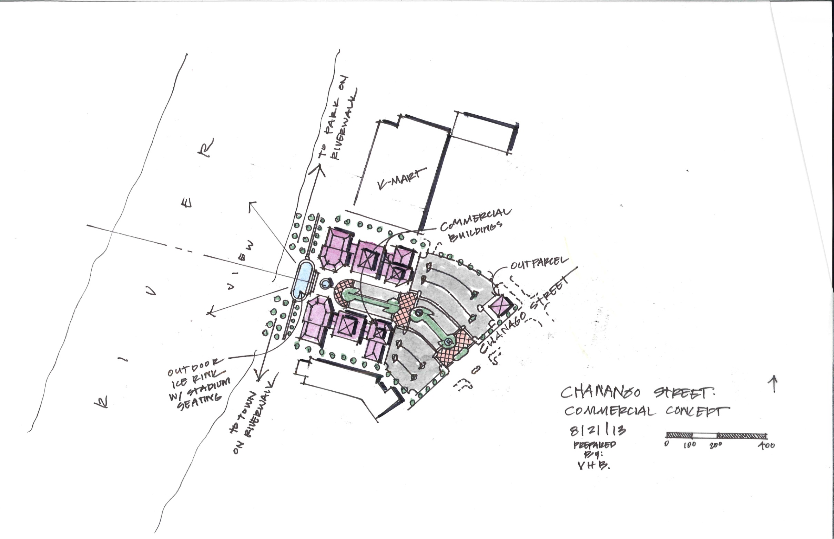
North Chenango River Corridor
Brownfield Opportunity Area
Land Planning Framework

Slide 14
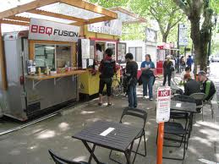
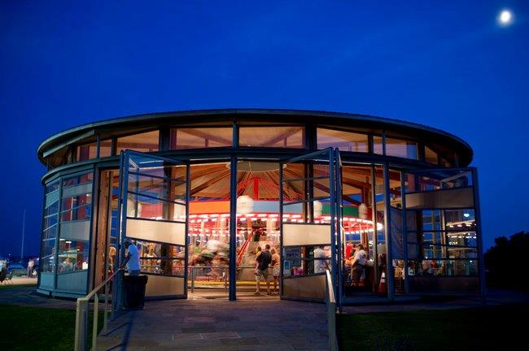
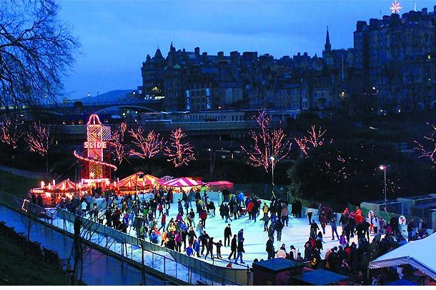
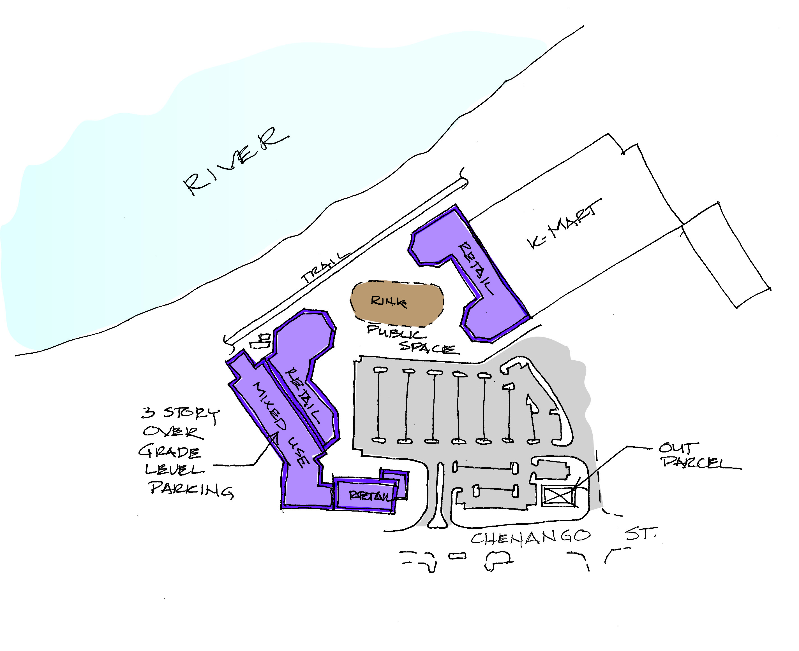
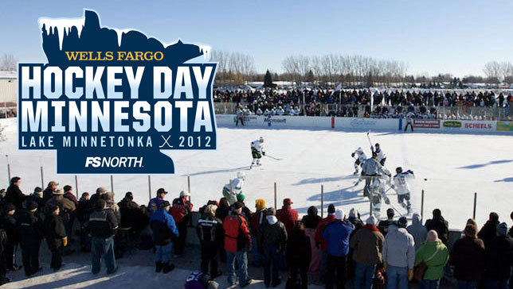
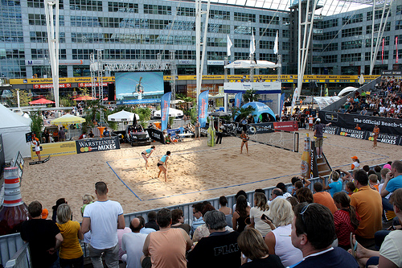
North Chenango River Corridor
Brownfield Opportunity Area
Land Planning Framework

Slide 15
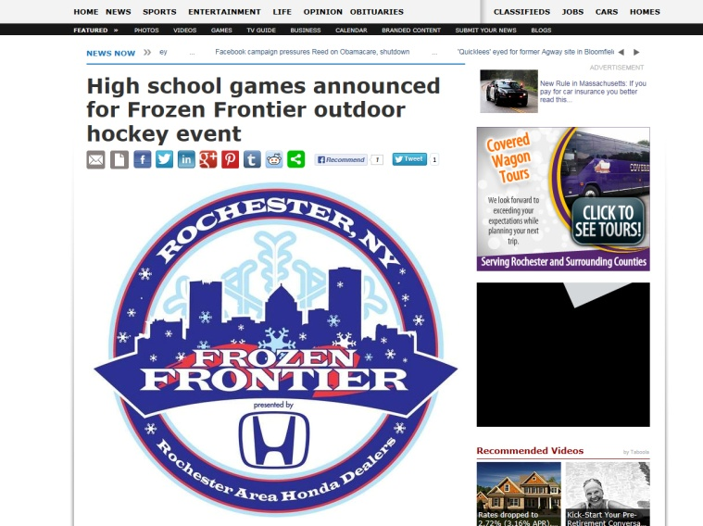

Slide 16
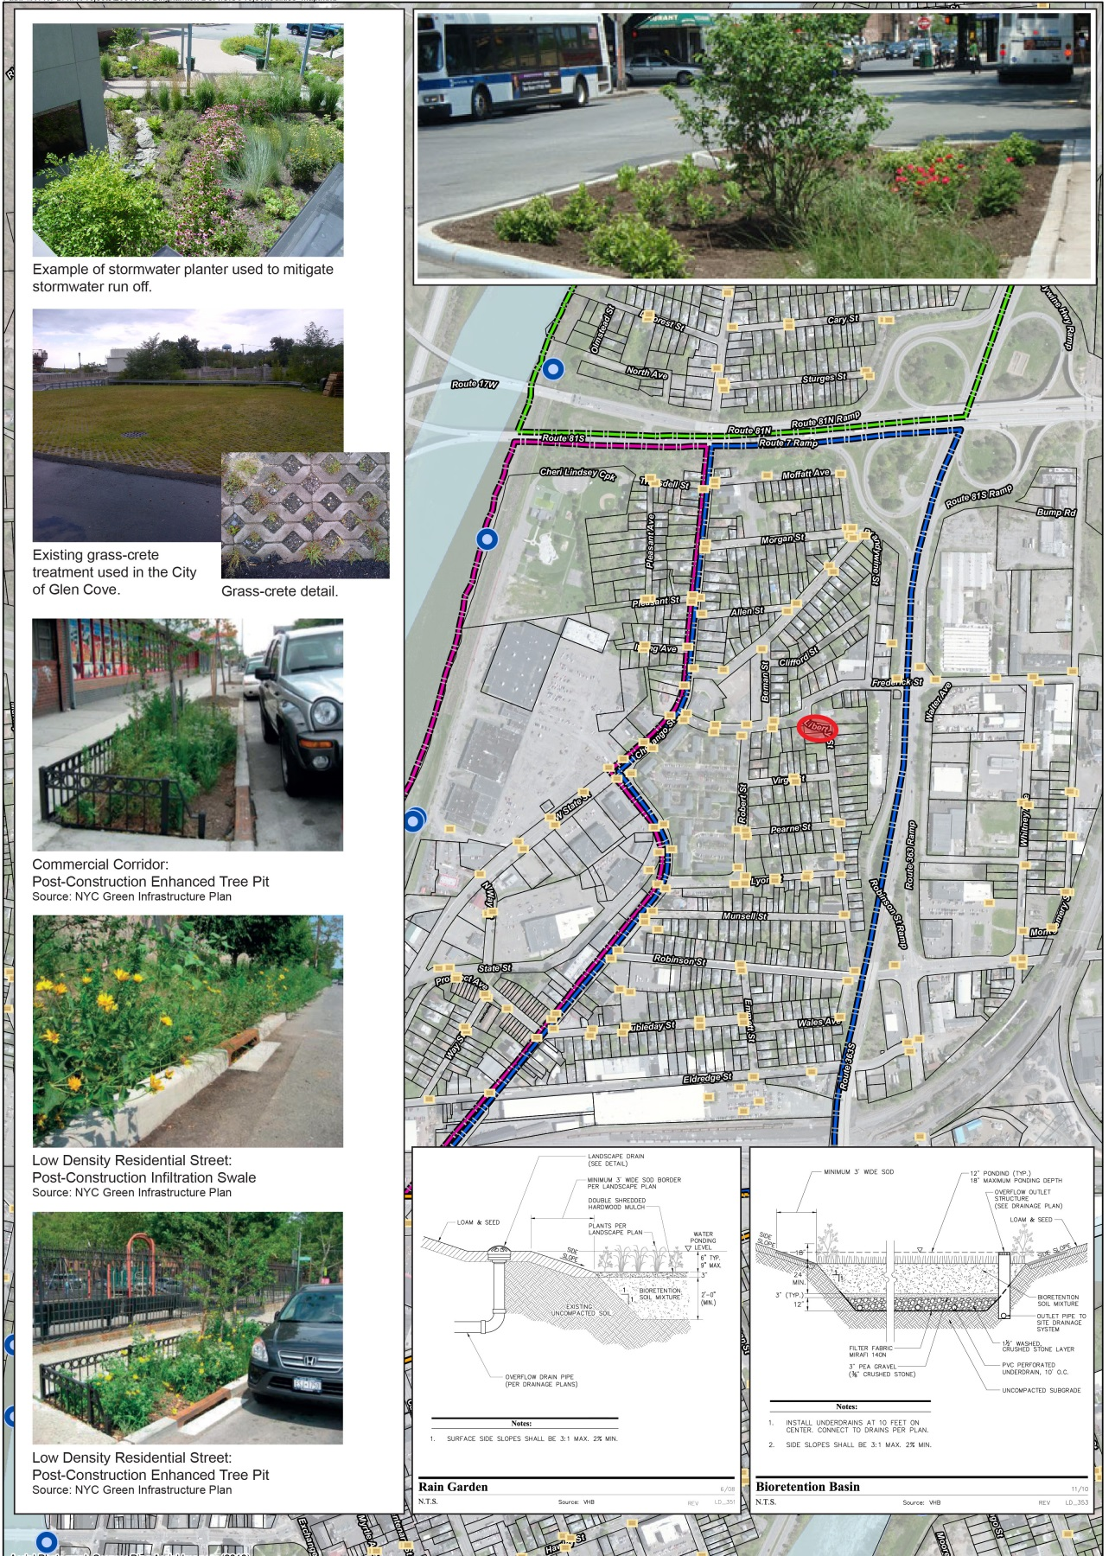
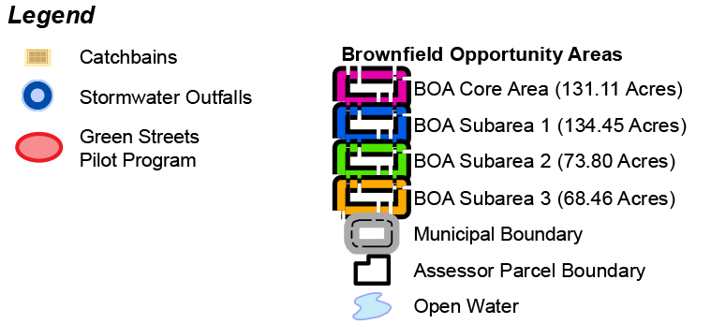
North Chenango River Corridor
Brownfield Opportunity Area
Green Infrastructure Techniques and
Low Impact Development
Example of Green Infrastructure/LID
Green Streets
Stormwater Planters
Permeable Pavers
Bio-Swales
Bio-Retention Facilities
Green Roofs
Tree Plantings and Trenches

Slide 17
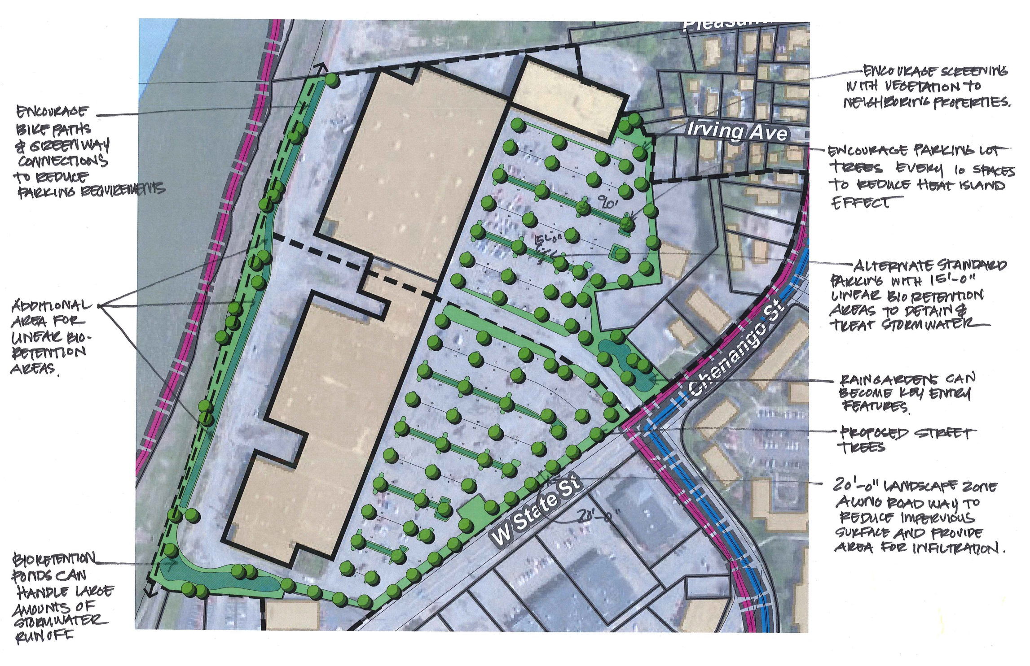
North Chenango River Corridor
Brownfield Opportunity Area
Green Infrastructure Techniques and
Low Impact Development

Slide 18
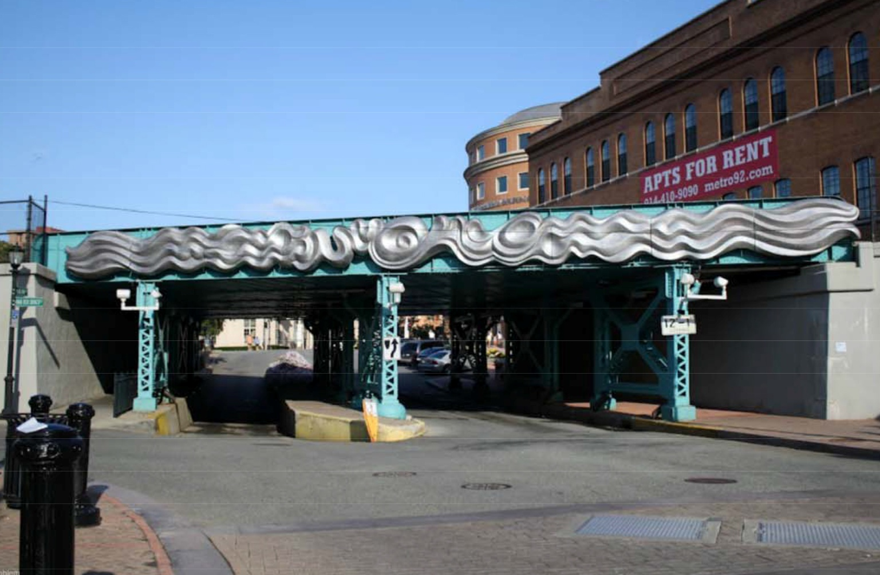
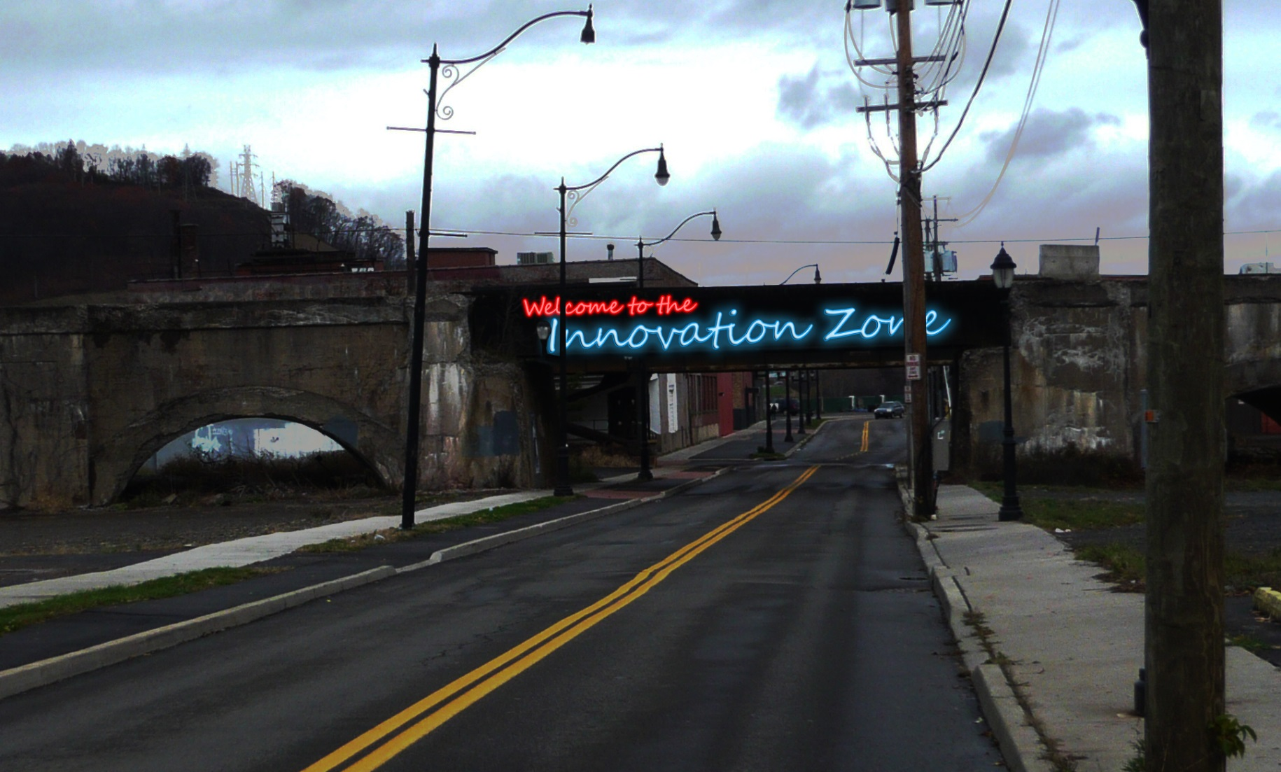
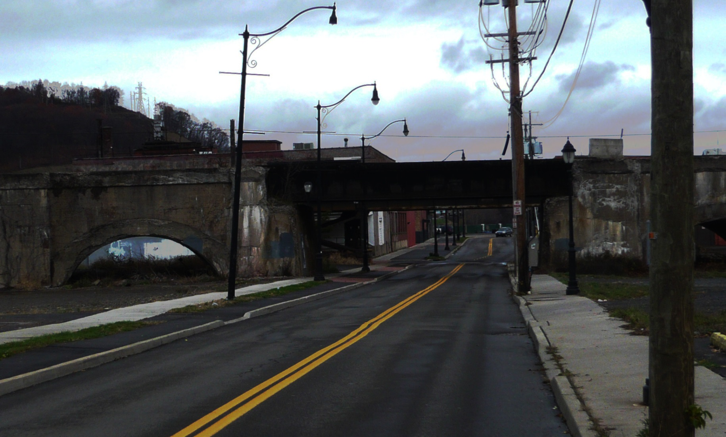
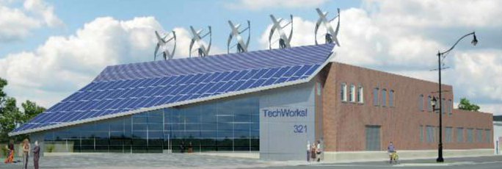
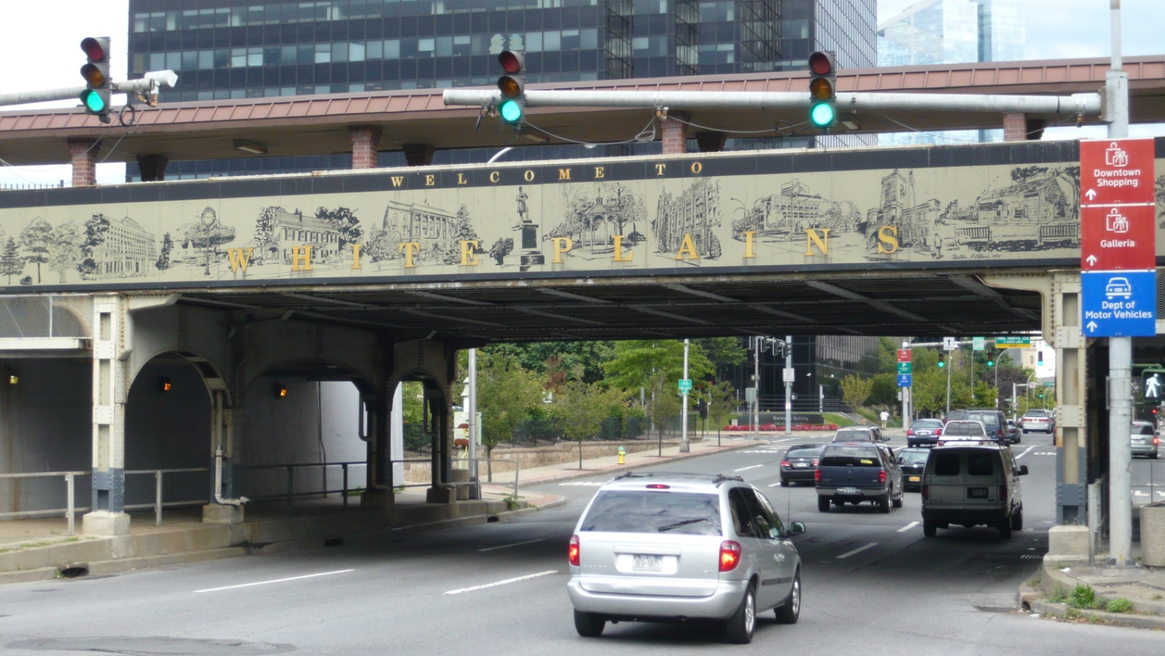
North Chenango River Corridor
Brownfield Opportunity Area
Innovation Zone
Proposed Gateway
Existing Gateway
Example Gateways
CT and I Building

Slide 19
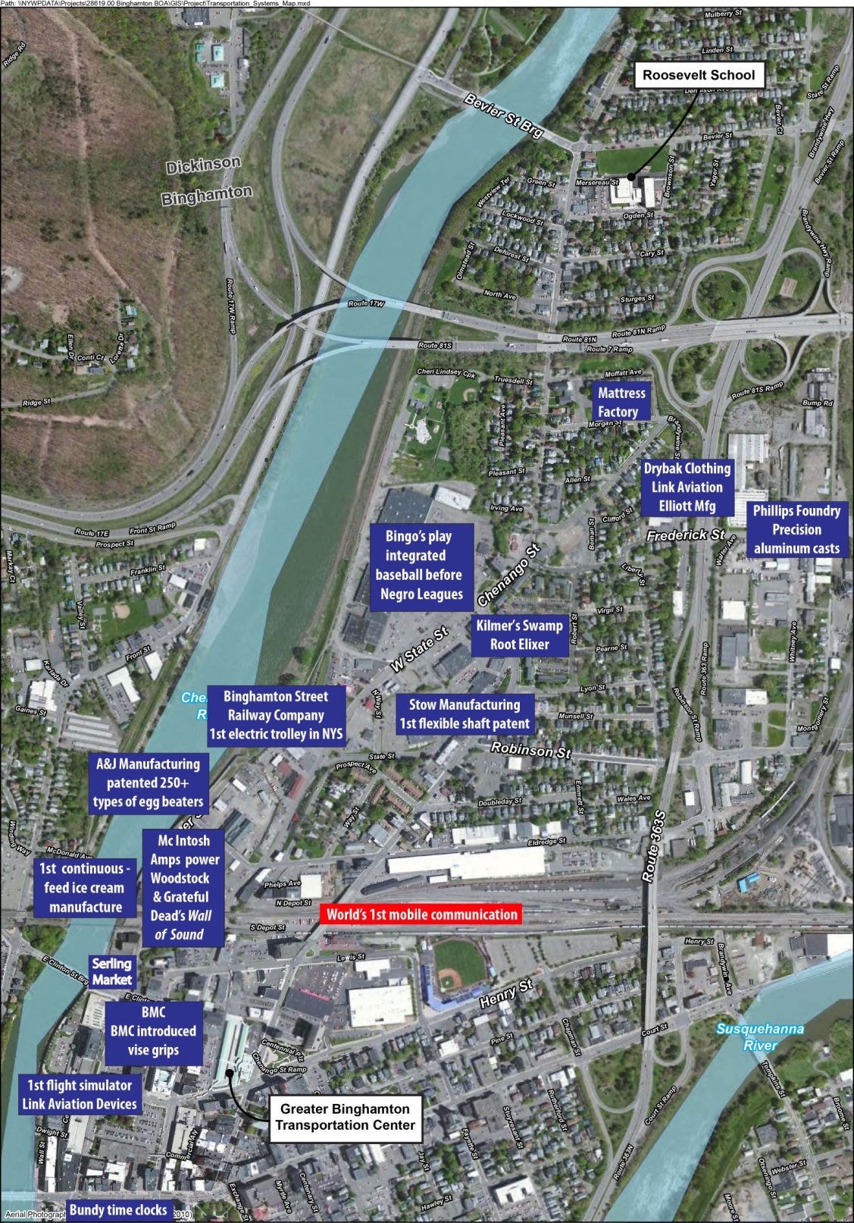
North Chenango River Corridor
Brownfield Opportunity Area
Innovation Zone
Interactive Tour using QR Codes and other Social Media Venues

Slide 20
Possible Redevelopment Tools
P³ - Public Private Partnership
Transportation / Streetscape/Complete Streets
Transportation Alternatives Program (TAP)
Highway Safety Improvement Program (HSIP)
Transportation Enhancement Program (TEP)
Consolidated Local Street and Highway Improvement Program (CHIPS)
Community Revitalization / Economic Development
Broome County Land Bank (property acquisition and assemblage)
Regional Economic Development Council Awards
Developer RFP
Site or Building Redevelopment
New York Main Streets Program
EPA Grants – Site Assessment / Site Cleanup
Tax Increment Financing (TIF)
Public Improvements and Infrastructure
Zoning
Consider Urban Village Overlay District for Core Redevelopment

Slide 21
End of Presentation
Q and A

Slide 22
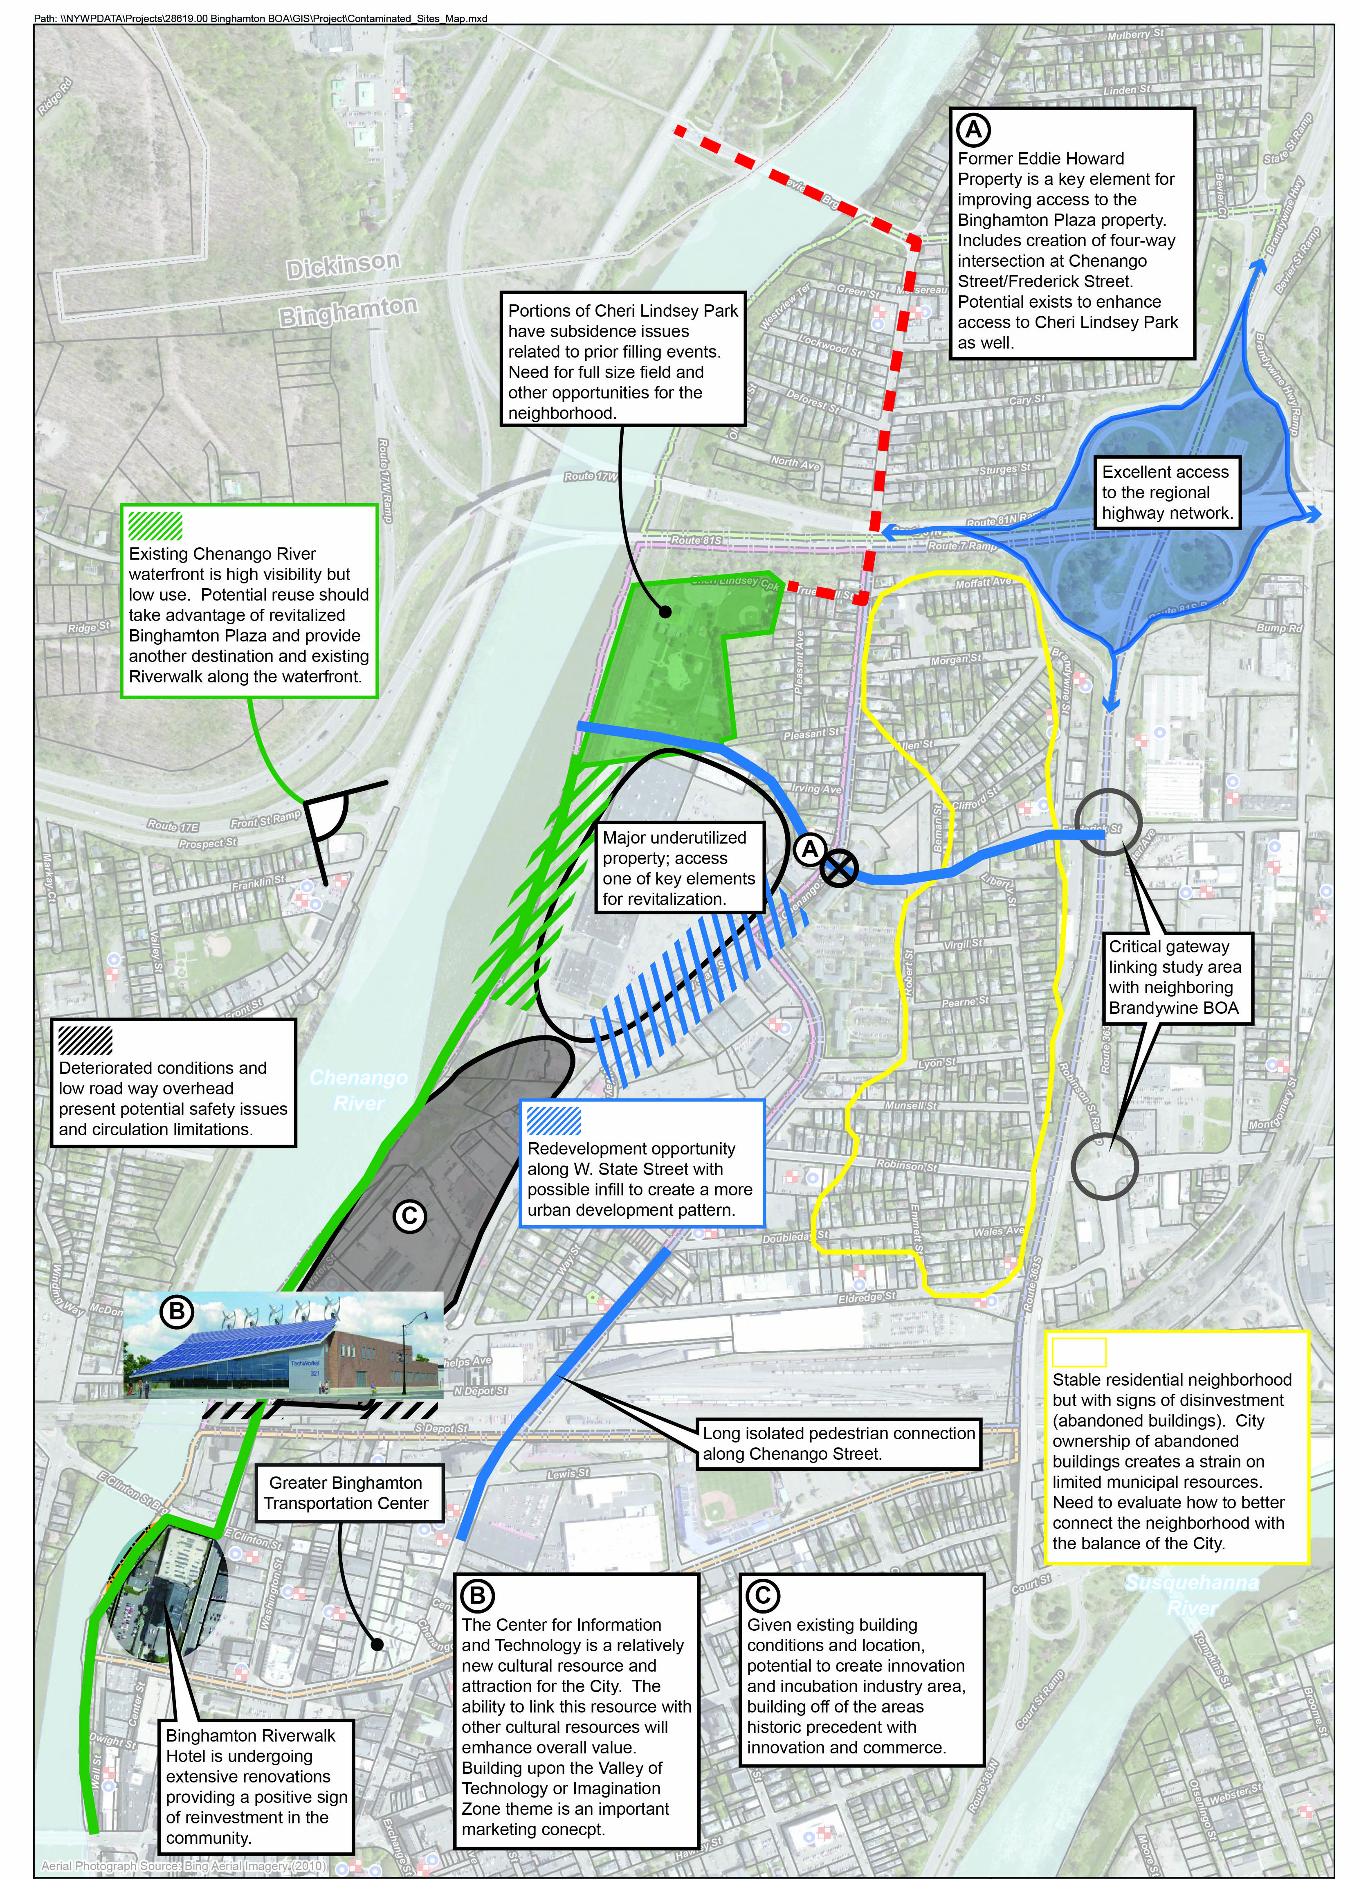
North Chenango River Corridor
Brownfield Opportunity Area
Preliminary Issues and Opportunities

